Slide 1
t level
For loops

Slide 2


Iteration in python – For loops
A key piece is the range()
In the example the loop will start at 1 and finish at 5, so
range(x, y) means loop from x up to but not including y

Slide 3

variable

Slide 4

What is output?

Slide 6

Step
What is output?

Slide 7


Slide 8
Range()
Generates a list of numbers
Generally used to iterate over with for loops
There's many use cases
Often you will want to use this when you want to perform an action n number of times

Slide 9
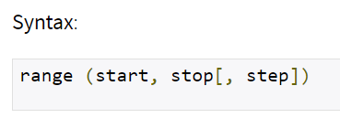
Range() syntax and arguments
range() takes three arguments
2 are optional
Start of sequence (default 0)
Stop is the upper limit
Step is the difference between each number

Slide 10

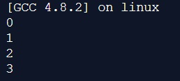

Slide 11

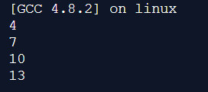

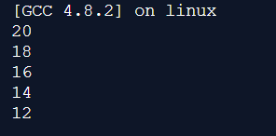

Slide 12
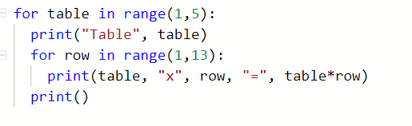
A loop inside a loop -- nested
What will this code do?

Slide 13
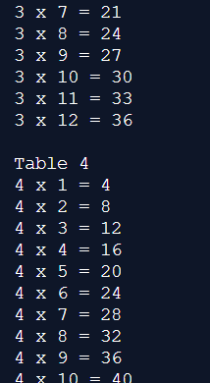
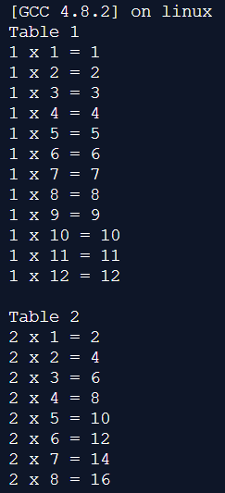

Slide 14

Looping over data structures
Well … not quite. We will get onto that in a later lecture.
But you can use for loops to loop over other things:
What will this output?

Slide 15
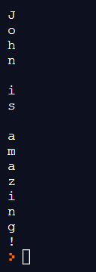
Looping over data structures
Well … not quite. We will get onto that in a later lecture.
But you can use for loops to loop over other things:
What will this output?

Slide 16
activities
There is an activity sheet on SharePoint to practice looping
You can/should use for loops in the previous worksheet
We will review the code at the start of next lecture
Make sure that you keep practicing your Python programming in between lectures

Slide 17
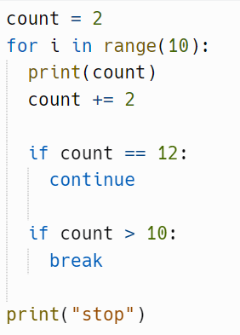
What will this output?

Slide 18
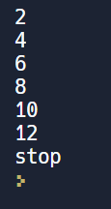
What will this output?

